Slide 1
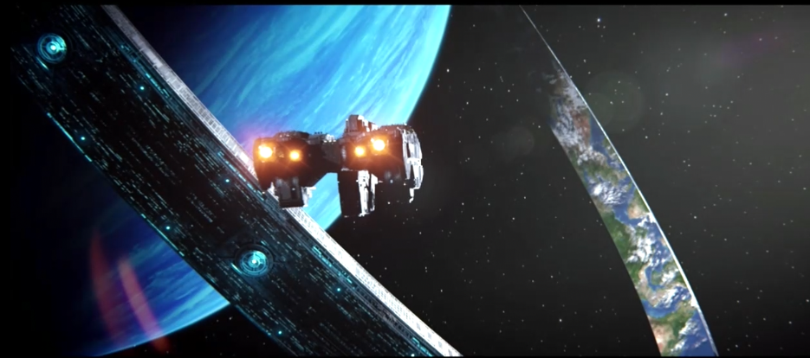
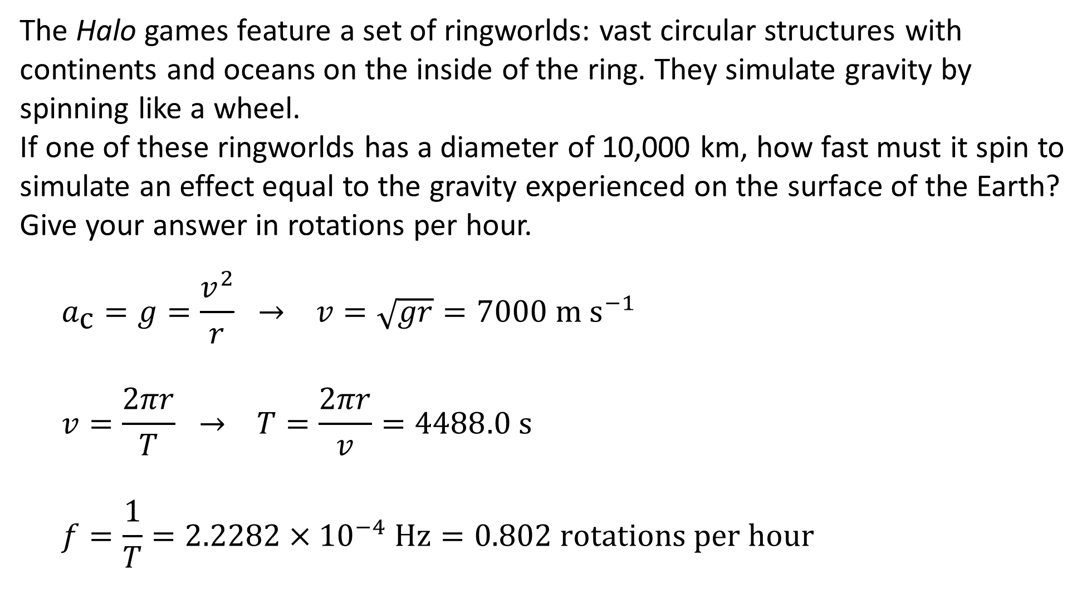
Review Question
The Halo games feature a set of ringworlds: vast circular structures with continents and oceans on the inside of the ring. They simulate gravity by spinning like a wheel.
If one of these ringworlds has a diameter of 10,000 km, how fast must it spin to simulate an effect equal to the gravity experienced on the surface of the Earth? Give your answer in rotations per hour.
$$a_{\text{c}}=g=\frac{v^{2}}{r} → v=\sqrt{gr}=7000 \text{m} {\text{s}}^{−1}$$
$$v=\frac{2πr}{T} → T=\frac{2πr}{v}=4488.0 \text{s}$$
$$f=\frac{1}{T}=2.2282×{10}^{−4} \text{Hz}=0.802 \text{rotations} \text{per} \text{hour}$$

Slide 2
Horizontal Circular Motion: Banked Turns

Slide 3
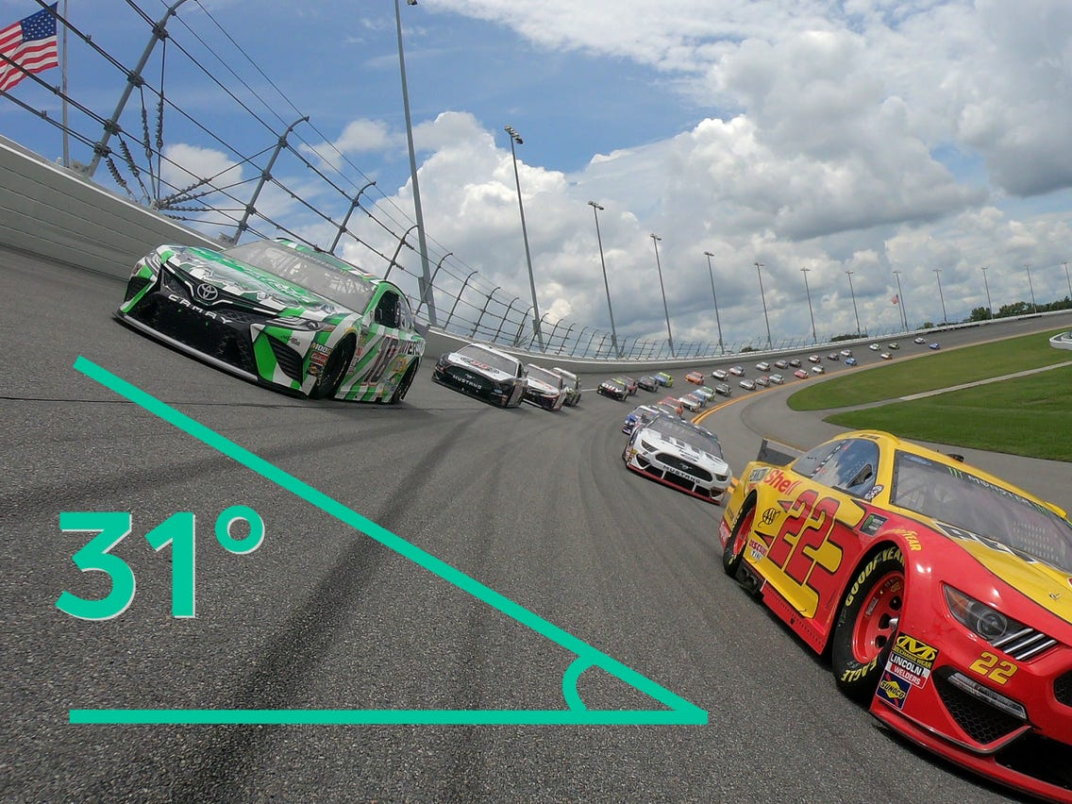
Banked Turns
When a car makes a turn on a horizontal road, it is relying on the friction between the road and its tyres to provide the required centripetal force.
However, for some turns – especially those which are likely to be travelled at high speeds where this friction may not be adequate – the road is not horizontal but is inclined.
As a result of this incline, a component of the normal force applied to the car is providing centripetal force (i.e. pushing it towards the centre of the circle).
This reduces the car’s reliance on friction and allows it to travel faster without losing traction.

Slide 4
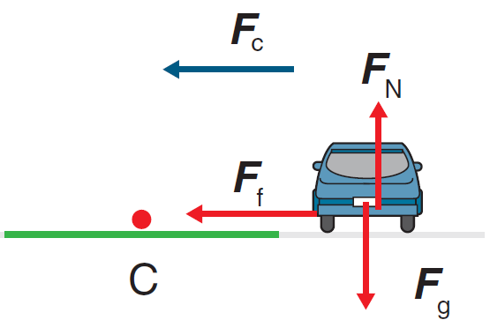
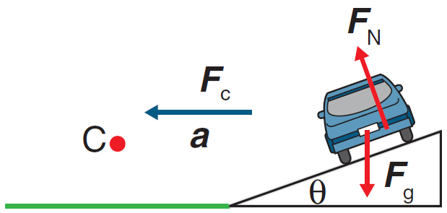
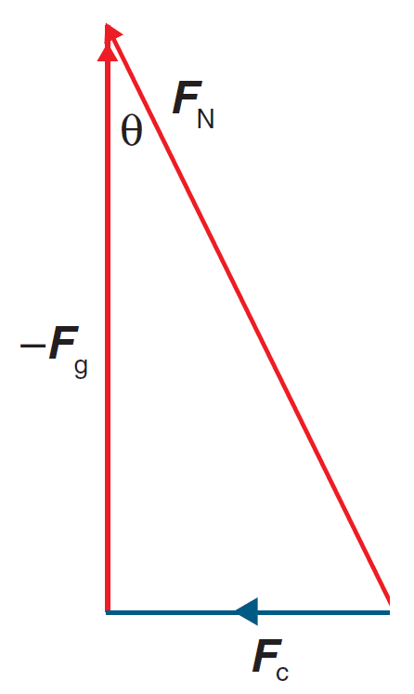
Banked Turns
On a horizontal road: F_{g} = F_{N} and F_{c} = F_{f}
On a banked road:
Friction is often (but not always!) ignored
F_{g} = F_{Nv}
F_{c} = F_{Nh} (or F_{c} = F_{Nh} + F_{fh})
The triangle formed by the bank is similar to the one formed by resolving the normal force

Slide 5
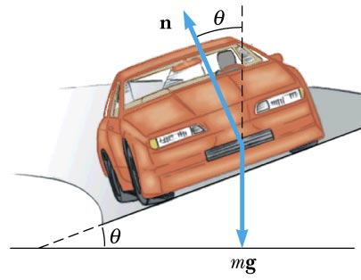
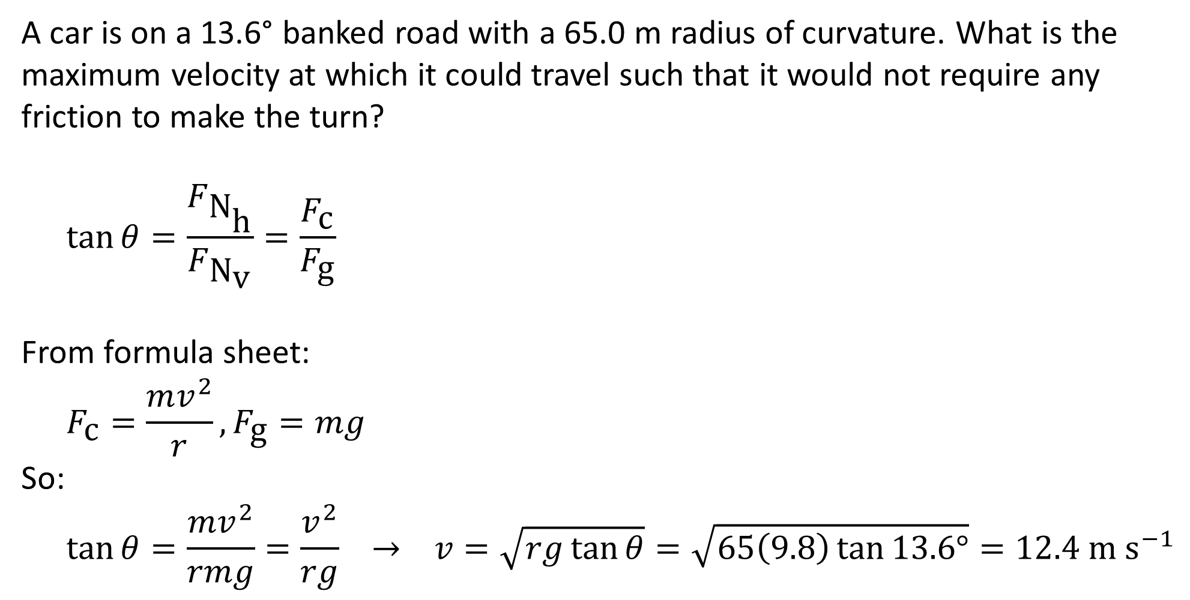
Example #1
A car is on a 13.6° banked road with a 65.0 m radius of curvature. What is the maximum velocity at which it could travel such that it would not require any friction to make the turn?
$$\tan{θ}=\frac{F_{{\text{N}}_{\text{h}}}}{F_{{\text{N}}_{\text{v}}}}=\frac{F_{\text{c}}}{F_{\text{g}}}$$
From formula sheet:
$$F_{\text{c}}=\frac{mv^{2}}{r}, F_{\text{g}}=mg$$
So:
$$\tan{θ}=\frac{mv^{2}}{rmg}=\frac{v^{2}}{rg} → v=\sqrt{rg\tan{θ}}=\sqrt{65\left(9.8\right)\tan{13.6°}}=12.4 \text{m} {\text{s}}^{−1}$$
Notes:
Note that the maximum velocity is not dependent on m.

Slide 6
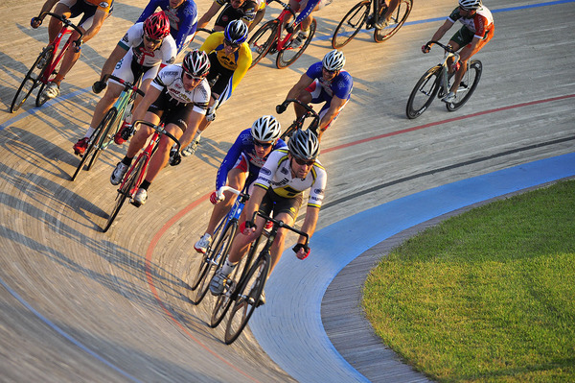
Example #2
An 85 kg cyclist on a 10 kg bike rides around a circular track of radius 100 m at a speed of 20 m s⁻¹.
Draw a free body diagram of the forces acting on him.
Calculate the time required to complete one lap of the track.
Calculate the centripetal force acting on him.
Assuming that he is not relying on friction, calculate the angle the cyclist makes with the vertical as he leans towards the centre of the circle.

Slide 7
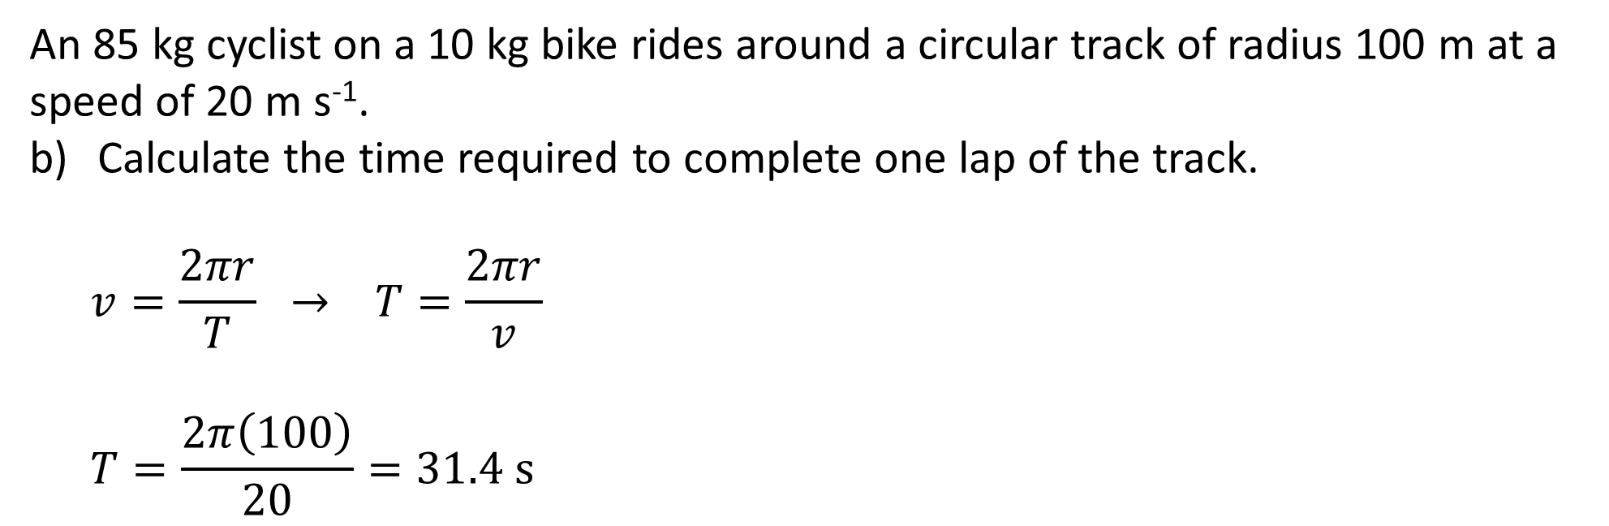
Example #2
An 85 kg cyclist on a 10 kg bike rides around a circular track of radius 100 m at a speed of 20 m s⁻¹.
Calculate the time required to complete one lap of the track.
$$v=\frac{2πr}{T} → T=\frac{2πr}{v}$$
$$T=\frac{2π\left(100\right)}{20}=31.4 \text{s}$$

Slide 8
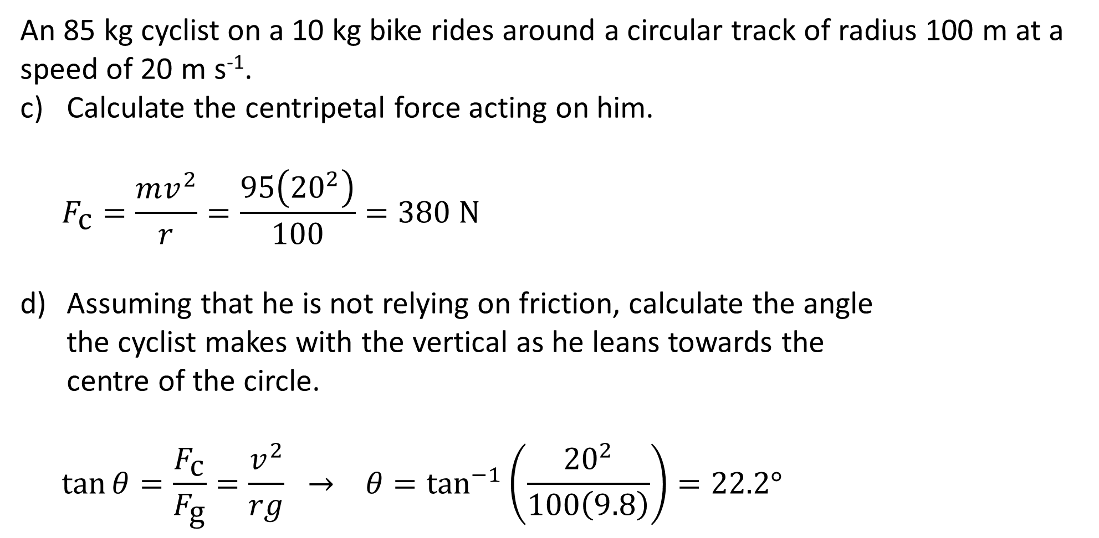
Example #2
An 85 kg cyclist on a 10 kg bike rides around a circular track of radius 100 m at a speed of 20 m s⁻¹.
Calculate the centripetal force acting on him.
$$F_{\text{c}}=\frac{mv^{2}}{r}=\frac{95\left({20}^{2}\right)}{100}=380 \text{N}$$
Assuming that he is not relying on friction, calculate the angle the cyclist makes with the vertical as he leans towards the centre of the circle.
$$\tan{θ}=\frac{F_{\text{c}}}{F_{\text{g}}}=\frac{v^{2}}{rg} → θ=\tan^{−1}\left(\frac{{20}^{2}}{100\left(9.8\right)}\right)=22.2°$$

Slide 9
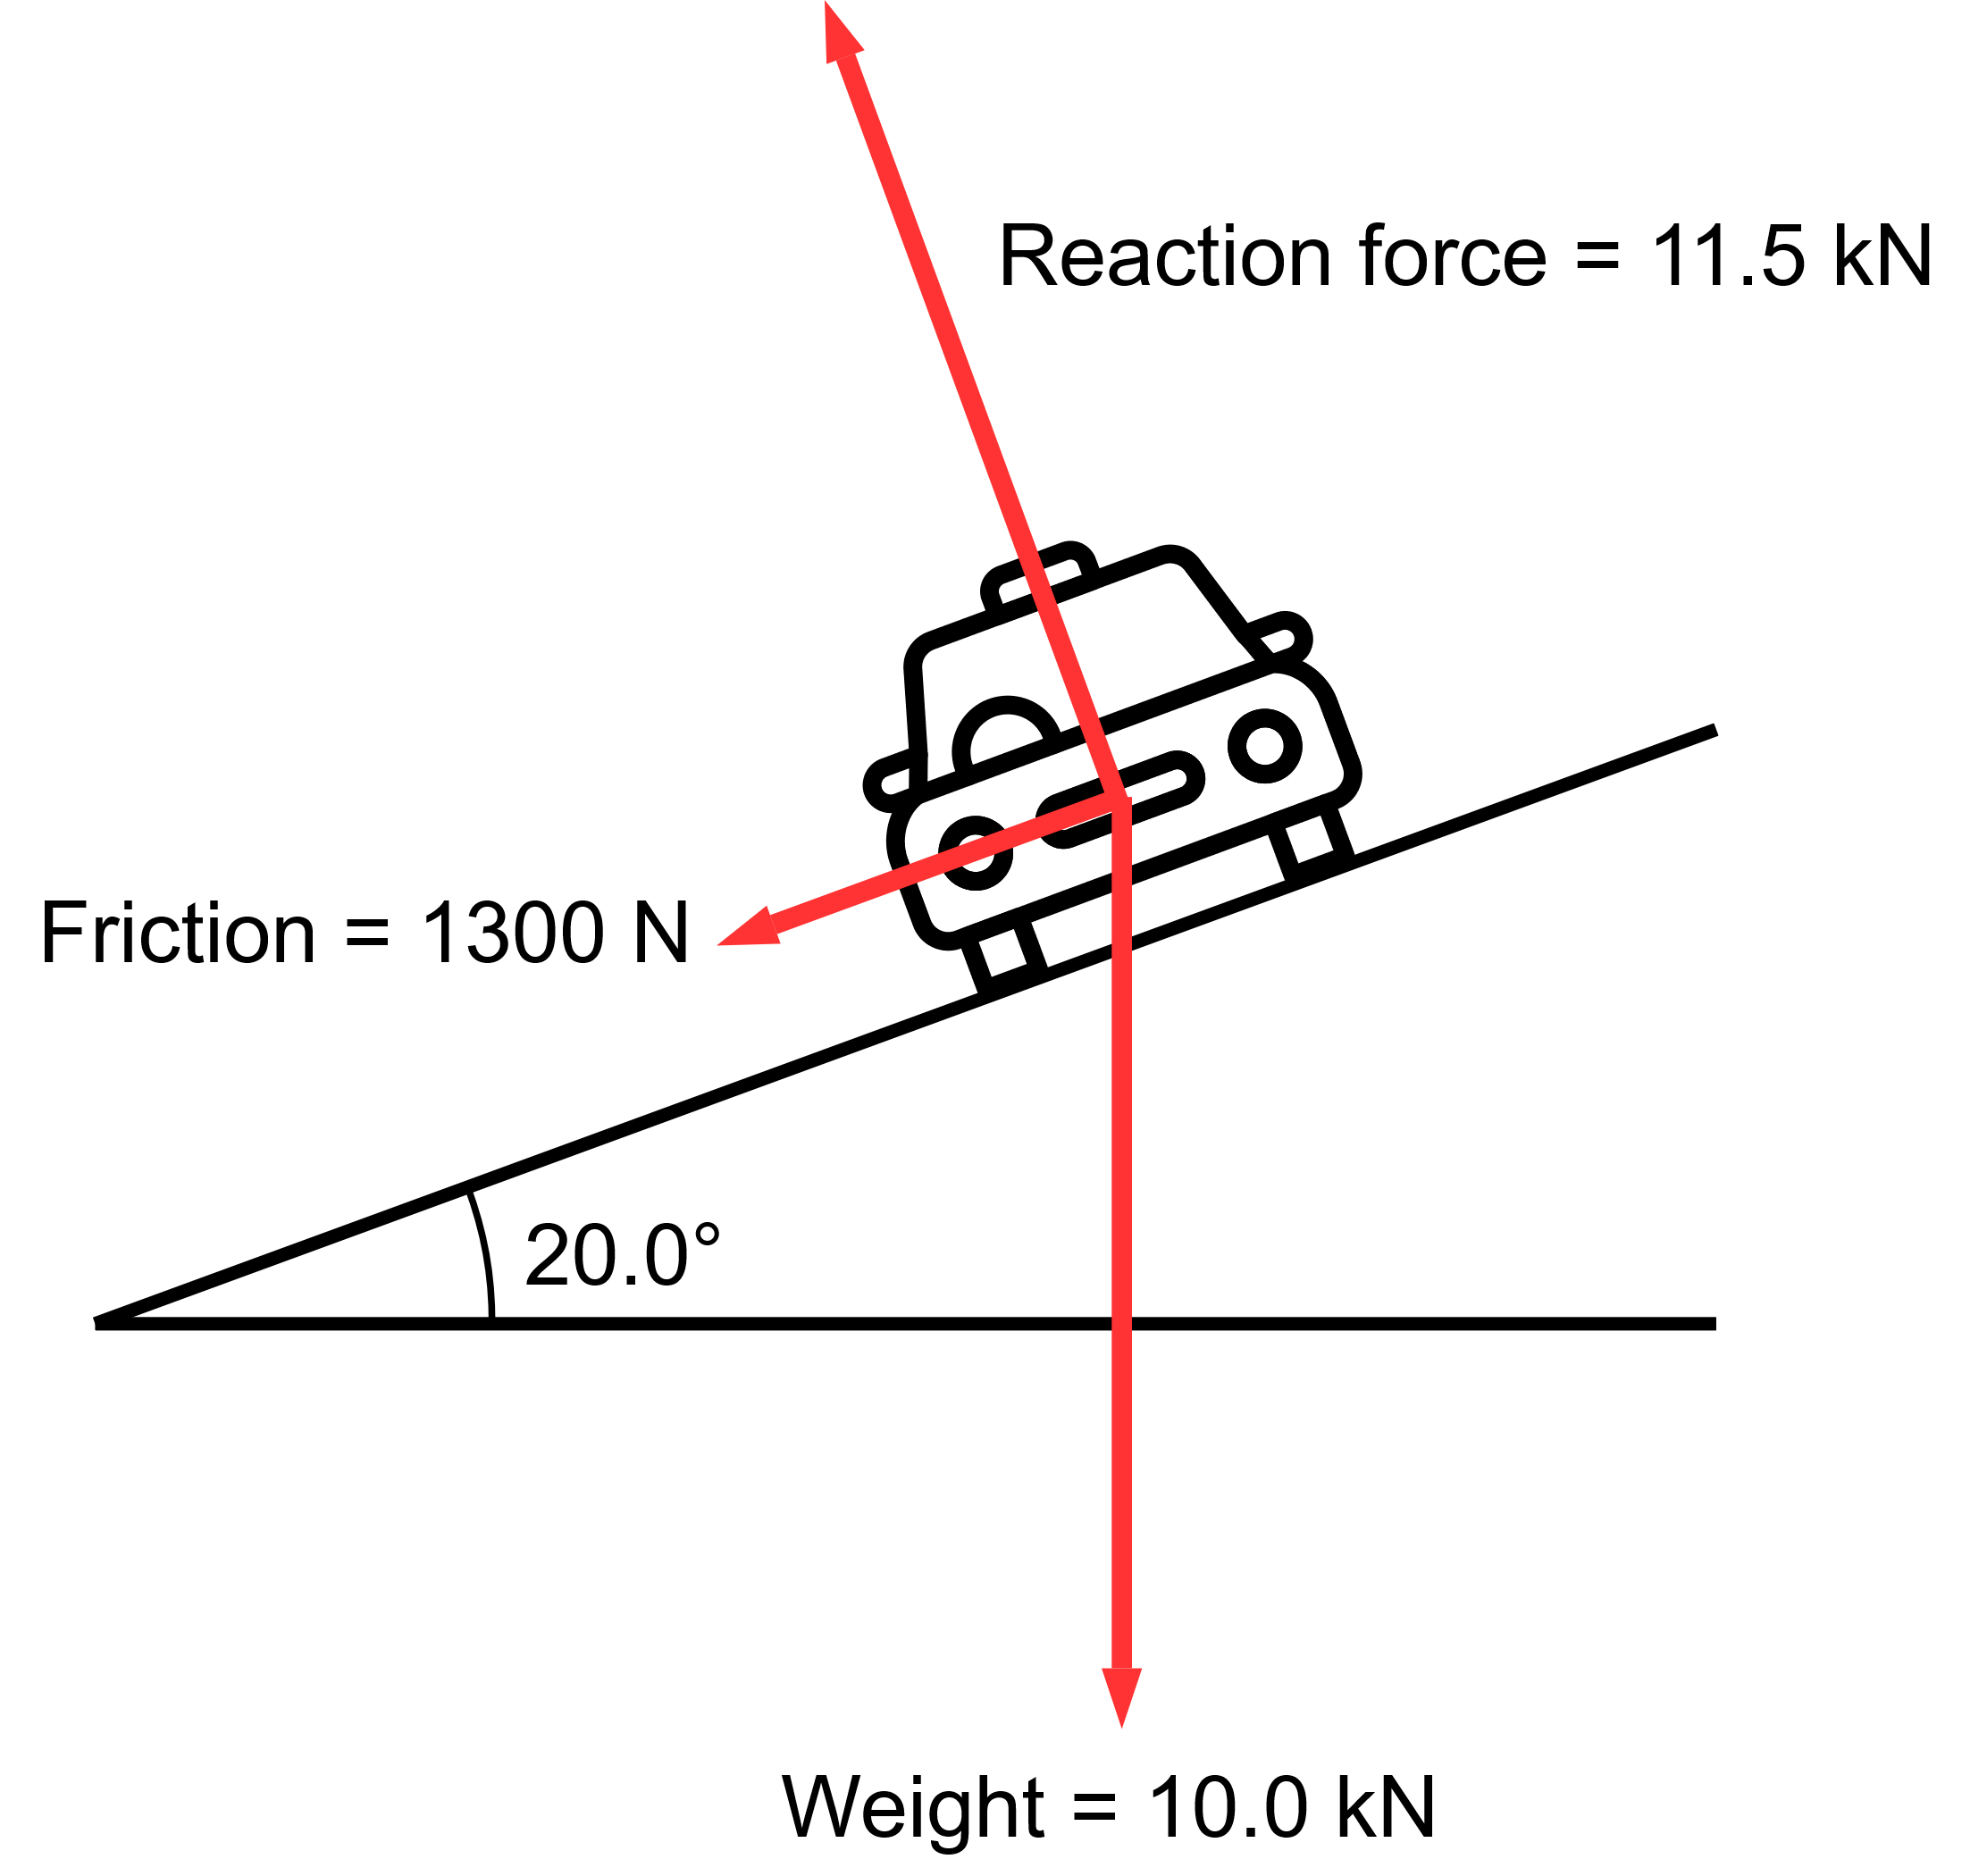
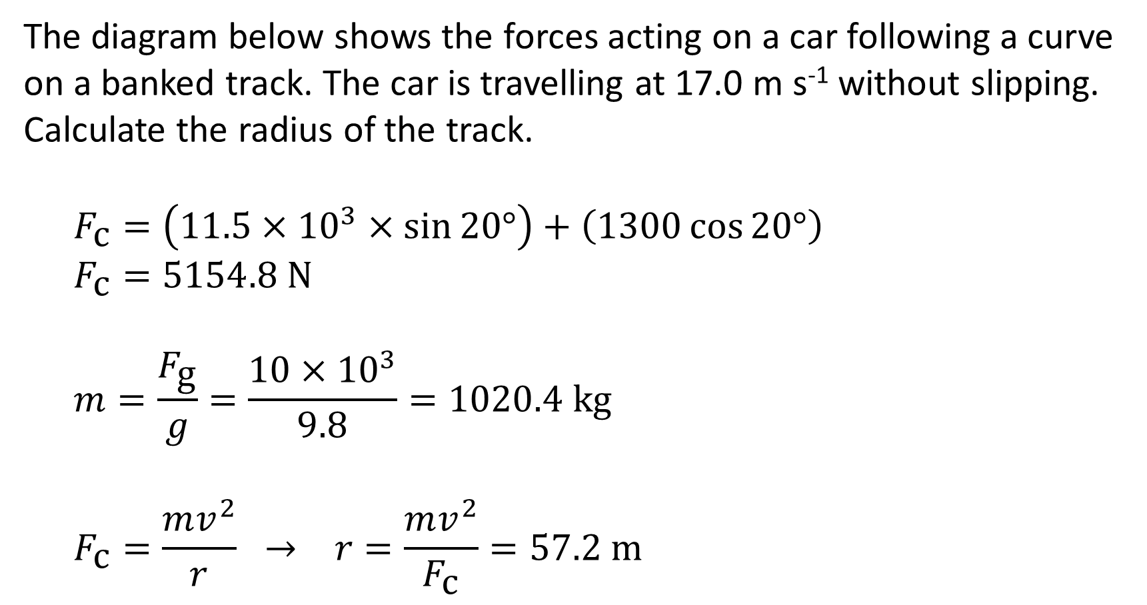
Example #3
The diagram below shows the forces acting on a car following a curve on a banked track. The car is travelling at 17.0 m s⁻¹ without slipping. Calculate the radius of the track.
$$F_{\text{c}}=\left(11.5×{10}^{3}×\sin{20°}\right)+\left(1300\cos{20°}\right)$$
$$F_{\text{c}}=5154.8 \text{N}$$
$$m=\frac{F_{\text{g}}}{g}=\frac{10×{10}^{3}}{9.8}=1020.4 \text{kg}$$
$$F_{\text{c}}=\frac{mv^{2}}{r} → r=\frac{mv^{2}}{F_{\text{c}}}=57.2 \text{m}$$

Slide 10
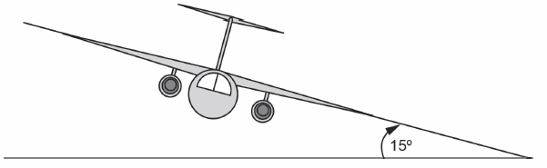
Example #4
An aircraft is flying horizontally with a constant speed of 600 km h⁻¹ at an altitude of 5000 m. The upward (lift) force provided by the wings that is necessary to keep the aircraft in level flight is 9.80 × 10⁴ N.
Show that the mass of the aircraft must be 1.00 × 10⁴ kg.
The pilot begins a turn by tilting the aircraft so that its wings are at 15.0° to the horizontal as shown. Assume that the airspeed does not change, and that the size and angle to the wing of the lift force remain constant.
Draw a free body diagram, labelling the forces acting on the aircraft. Ignore drag (friction) and thrust forces directed into and out of the page.

Slide 11
Example #4
An aircraft is flying horizontally with a constant speed of 600 km h⁻¹ at an altitude of 5000 m. The upward (lift) force provided by the wings that is necessary to keep the aircraft in level flight is 9.80 × 10⁴ N.
The mass of the aircraft is 1.00 × 10⁴ kg.
The pilot begins a turn by tilting the aircraft so that its wings are at 15.0° to the horizontal as shown. Assume that the airspeed does not change, and that the size and angle to the wing of the lift force remain constant.
Calculate the horizontal radius of the aircraft’s turn.
Without using any calculations, describe any effects this turn will have on the altitude of the aircraft.
Notes:
c) 11.0 km (10952 m)

